Slide 1
Module 3 (Part 2)

Slide 2
Outline
Data Control Commands
Views in SQL
Triggers
Assertions
Security and Authorization in SQL

Slide 3
Introduction to DCL
DCL stands for Data Control Language.
DCL is used to control user access in a database.
This command is related to the security issues.
Using DCL command, it allows or restricts the user from accessing data in database schema.
DCL commands are as follows,
GRANT
REVOKE
It is used to grant or revoke access permissions from any database user.

Slide 4
GRANT COMMAND
GRANT command gives user's access privileges to the database.
This command allows specified users to perform specific tasks.
Syntax: GRANT <privilege list> ON <relation name or view name> TO <user/role list>;
GRANT ALL ON employee TO ABC; [WITH GRANT OPTION]

Slide 5
REVOKE COMMAND
REVOKE command is used to cancel previously granted or denied permissions.
This command withdraw access privileges given with the GRANT command.
It takes back permissions from user.
Syntax: REVOKE <privilege list> ON <relation name or view name> FROM <user name>;
REVOKE UPDATE ON employee FROM ABC;

Slide 6
Difference between GRANT and REVOKE command.
GRANT | REVOKE
GRANT command allows a user to perform certain activities on the database. | REVOKE command disallows a user to perform certain activities.
It grants access privileges for database objects to other users. | It revokes access privileges for database objects previously granted to other users.
Example: GRANT privilege_name ON object_name TO { user_name|PUBLIC|role_name } [WITH GRANT OPTION]; | Example: REVOKE privilege_name ON object_name FROM { user_name|PUBLIC|role_name }

Slide 7
Introduction to Views
View is a virtual table that contains rows and columns, just like a real table.
It is used to hide complexity of query from user.
A virtual table does not exist physically, it is created by a SQL statement that joins one or more tables.

Slide 8
Views in SQL
In SQL, a view is a virtual table containing the records of one or more tables based on SQL statement executed.
Just like a real table, view contains rows and columns.
You can add SQL functions, WHERE, and JOIN statements to a view and present the data as if the data were coming from one single table
The changes made in the table get automatically reflected in original table and vice versa

Slide 9
Views in SQL
Purpose of View:
View is very useful in maintaining the security of database
Consider a base table employee having following data
Emp_id | Emp_name | Salary | Address
E1 | Kunal | 8000 | Camp
E2 | Jay | 7000 | Tilak Road
E3 | Radha | 9000 | Somwar Peth
E4 | Sagar | 7800 | Warje
E5 | Supriya | 6700 | LS Road

Slide 10
Views in SQL
Now just consider we want to give this table to any user but don’t want to show him salaries of all the employees
In that we can create view from this table which will contain only the part of base table which we wish to show to user
Emp_id | Emp_name | Address
E1 | Kunal | Camp
E2 | Jay | Tilak Road
E3 | Radha | Somwar Peth
E4 | Sagar | Warje
E5 | Supriya | LS Road

Slide 11
Views in SQL
Also in multiuser system, it may be possible that more than one user may want to update the data of some table
Consider two users A and B want to update the employee table.
In such case we can give views to both these users
These users will make changes in their respective views, and their respective changes are done in the base table automatically

Slide 12
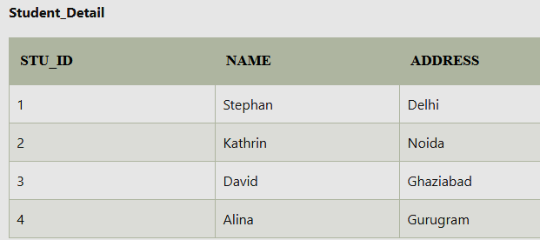
1. Creating View
A view can be created using the CREATE VIEW statement.
We can create a view from a single table or multiple tables.

Slide 13
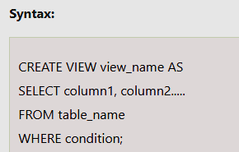
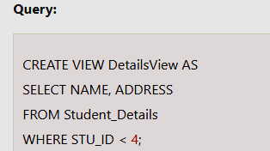
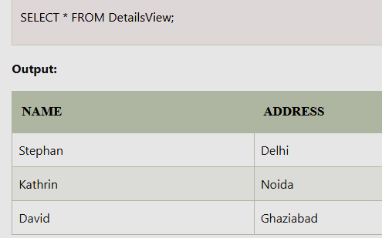
1. Creating View

Slide 14
1. Creating View
Creating View from multiple tables

Slide 15
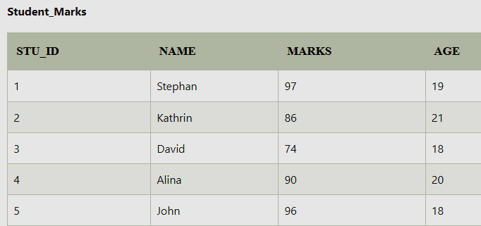
1. Creating View

Slide 16
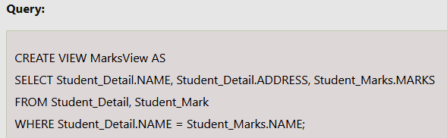
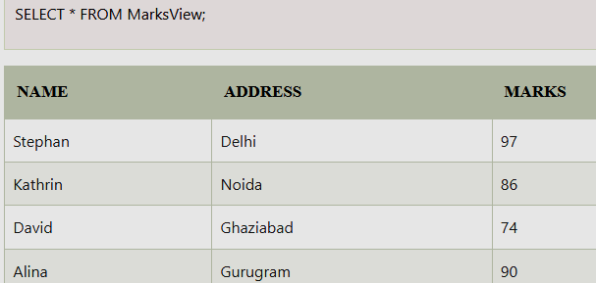
1. Creating View

Slide 17

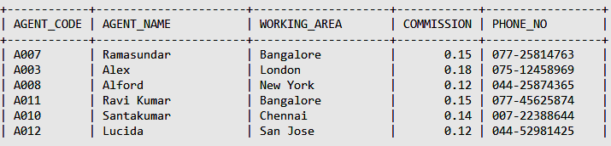
2. Updating View
Update query is used to update the records of view
Updation in view reflects the original table also means same changes will be made in the original table

Slide 18

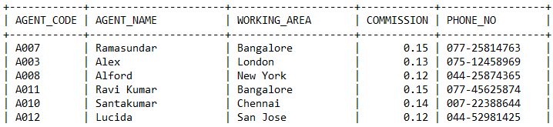
2. Updating View

Slide 19
2. Updating View
In case of view containing joins between multiple tables, only insertion and updation in the view is allowed, deletion is not allowed
Data modification is not allowed in the view which is based on union queries
Data modification is not allowed in the view where GROUPBY or DISTINCT statements are used
In view, text and image columns can’t be modified

Slide 20
Regarding view updates
View with single defining table is updatable only if view attributes contains primary key of the base relation
View defined on multiple tables using joins are generally not updatable
Views defined using grouping and aggregate functions are not updatable.

Slide 21
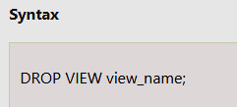

3. Dropping View
Drop query is used to delete a view
Example:

Slide 22
Types of Views
There are two types of Views:
Simple View
The views which are based on only one table called as Simple view.
Allow to perform DML (Data Manipulation Language) operations with some restrictions.
Query defining simple view cannot have any join or grouping condition.

Slide 23
Types of Views
2. Complex View
The views which are based on more than one table called as complex view.
Do not allow DML operations to be performed.
Query defining complex view can have join or grouping condition.

Slide 24
Difference: Simple and Complex View
Simple View | Complex View
Contains only one single base table or is created from only one table. | Contains more than one base table or is created from more than one table.
We cannot use group functions like MAX(), COUNT(), etc. | We can use group functions.
INSERT, DELETE and UPDATE are directly possible on a simple view. | We cannot apply INSERT, DELETE and UPDATE on complex view directly.
Example: CREATE VIEW Employee AS SELECT Empid, Empname FROM Employee WHERE Empid = ‘030314’; | Example: CREATE VIEW EmployeeByDepartment AS SELECT e.emp_id, d.dept_id, e.emp_name FROM Employee e, Department d WHERE e.dept_id=d.dept_id;

Slide 25
Advantages of View
View provides data security for the same base tables.
It allows different users to view the same data in different ways at the same time.
It is used to represent additional information like derived columns.
It is used to hide complex queries.
It presents a consistent, unchanged image of the database structure, even if the tables are split or renamed.
It does not allow direct access to the tables of the data dictionary.

Slide 26
Disadvantages of View
We cannot use DML operations on View, if there is more than one table.
When table is dropped view becomes inactive.
View is a database object, so it occupies the space.
Without table, view will not work.
Updating is possible for simple view but not for complex views, they are read only type of views.

Slide 27
Triggers
A trigger is a procedure that is automatically invoked by the DBMS in response to specific alteration database or a table in database.
Triggers are stored in database as a simple database object.
A database that has a set of associated triggers is called an active database.
A database trigger enables DBA (Database Administrators) to create additional relationships between separate databases.

Slide 28
Triggers
Need/Purpose of Triggers
To generate data automatically
Validate input data
Replicate data to different files to achieve data consistency
Components of Trigger (E-C-A Model)
Event (E): SQL statement that causes the trigger to fire (or activate). This event may be insert, update or delete operation database table.
Condition (C) : A condition that must be satisfied for execution of trigger.
Action (A) : This is code or statement that execute when triggering condition is satisfied and trigger is activated on database table.

Slide 29
Triggers
Trigger syntax
CREATE [OR REPLACE] TRIGGER <Trigger Name>
[<ENABLE | DISABLE>]
<BEFORE|AFTER>
<INSERT|UPDATE | DELETE>
ON <Table_ Name>
[FOR EACH ROW]
DECLARE
<Variable_ Definitions>
BEGIN
<TriggerCode> ;
END;

Slide 30
Triggers
Trigger Parameters
OR REPLACE | If trigger is already present then drop and recreate the trigger
< Trigger Name> | Name of trigger to be created.
BEFORE | Indicates that trigger is to be fired before the triggering event occurs
AFTER | Indicates that trigger is to be fired After the triggering event occurs
INSERT | Indicates that trigger is to be fired whenever insert statement adds a row to table
UPDATE | Indicates that trigger is to be fired whenever Update statement modifies a row in a table
DELETE | Indicates that trigger is to be fired whenever delete statement removes a row from table

Slide 31
Triggers
Trigger Parameters
FOR EACH ROW | Trigger will be fired only once for each row.
WHEN | Contains condition that must be satisfied to execute trigger
<trigger code> | Code to be executed whenever triggering event occurs

Slide 32
Trigger Types
Row level Triggers
A row level trigger is fired each time the table is affected by the triggering statement
For example, if an UPDATE statement changes multiple rows in a table, a row trigger is fired once for each row affected by the UPDATE statement
If a triggering statement do not affect any row then a row trigger will not run only.
IF FOR EACH ROW clause is written that means trigger is row level trigger.

Slide 33
Trigger Types
Statement level triggers
A statement level trigger is fired only once on behalf of the triggering statement, irrespective of the number of rows in the table that are affected by the triggering statement.
This trigger executes once even if no rows are affected.
For example, if a DELETE statement deletes several rows from a table, a statement-level DELETE trigger fired only one time

Slide 34
Trigger Classification
The classification of trigger is based on various parameters:
Classification based on the timing
BEFORE Trigger: This trigger is fired before the occurrence of specified event.
AFTER Trigger: This trigger is fired after the occurrence of specified event.
Classification based on the level
STATEMENT level Trigger : This trigger is fired for once for the specified event statement.
ROW level Trigger : This trigger is fired for all the records which are affected in the specified event. (only for DML)

Slide 35
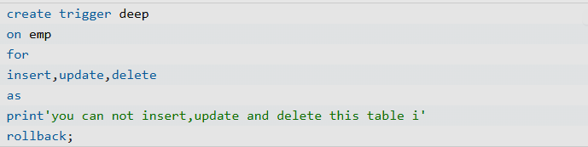
DML Trigger
The DML triggers are fired in response to DML (Data Manipulation Language) command events that start with Insert, Update, and Delete.
Like insert_table, Update_view and Delete_table.

Slide 36
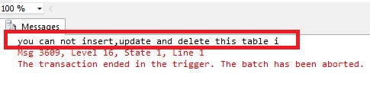
DML Trigger
When we insert, update, or delete a table in a database, then the following message appears,

Slide 37
Trigger Example: Row Level Trigger
Creating a trigger on employee table whenever a new employee added, a comment is written in EmpLog table
CREATE OR REPLACE TRIGGER AutoRecruit
AFTER INSERT ON EMP
FOR EACH ROW
BEGIN
INSERT into EmpLog values(“Employee inserted”);
END;
Trigger created

Slide 38
Trigger Example
mysql>INSERT into EMP (1, ‘abc’, ‘manager’, 30000);
1 row created
mysql> SELECT * from EmpLog;
STATUS
--------------
Employee inserted

Slide 39
Trigger Example: Row Level Trigger
There comes a new student add him to CS
mysql>
CREATE TRIGGER CSAutoRecruit
AFTER INSERT ON Student
FOR EACH ROW
BEGIN
INSERT into Recruit(1,’abc’,’CS’);
END

Slide 40
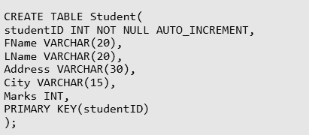
Trigger Example:2

Slide 41

Trigger Example:2
Before Insert
Here when we insert data into the student table automatically the trigger will be invoked.
The trigger will add 100 to the marks column into the student column.

Slide 42

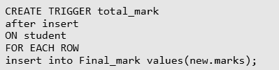
Trigger Example:2
After Insert
To use this variant we need one more table i.e, Percentage where the trigger will store the results. Use the below code to create the Percentage Table.
Here when we insert data to the table, total_mark trigger will store the result in the Final_mark table.

Slide 43
Trigger Advantages
Triggers are useful for enforcing referential integrity, which preserves the defined relationships between tables when you add, update or delete the rows in those tables.
Make sure that a column is filled with default information.
After finding that the new information is inconsistent with the database, raise an error that will cause the entire transaction to roll back.

Slide 44
Trigger Disadvantages
Invisible from client applications − Basically MySQL triggers are invoked and executed invisible from the client applications hence it is very much difficult to figure out what happens in the database layer.
Impose load on server − Triggers can impose a high load on the database server.
Not recommended for high velocity of data − Triggers are not beneficial for use with high-velocity data i.e. the data when a number of events per second are high. It is because in case of high-velocity data the triggers get triggered all the time.

Slide 45
Assertions
An assertion is a predicate expressing a condition we wish the database to always satisfy.
Domain constraints, functional dependency and referential integrity are special forms of assertion.
Where a constraint cannot be expressed in these forms, we use an assertion, e.g.
Ensuring the sum of loan amounts for each branch is less than the sum of all account balances at the branch.
Ensuring every loan customer keeps a minimum of $1000 in an account.
Syntax
create assertion assertion-name check predicate

Slide 46
Q. Ensuring the sum of loan amounts for each branch is less than the sum of all account balances at the branch.
create assertion sum-constraint check
(not exists (select * from branch
where (select sum)amount) from loan
where (loan.bname = branch.bname >=
(select sum)amount) from account
where (account.bname = branch.bname)))

Slide 47
Ensuring every loan customer keeps a minimum of $1000 in an account.
create assertion balance-constraint check
(not exists (select * from loan L
(where not exists (select *
from borrower B, depositor D, account A
where L.loan# = B.loan# and B.cname = D.cname and D.account# = A.account# and A.balance >= 1000 )))

Slide 48
When an assertion is created, the system tests it for validity. If the assertion is valid, any further modification to the database is allowed only if it does not cause that assertion to be violated.
This testing may result in significant overhead if the assertions are complex. Because of this, the assert should be used with great care.
Some system developer omits support for general assertions or provides specialized form of assertions that are easier to test.

Slide 49
Security and Authorization
Authentication
Authentication is the process of confirming that a user logs in only in accordance with the rights to perform the activities he is authorized to perform. User authentication can be performed at operating system level or database level itself.
type of security authentication process
Based on Operating System authentications.
Lightweight Directory Access Protocol (LDAP)

Slide 50
Authorization
access the Database and its functionality within the database system, which is managed by the Database manager.
permissions available for authorization
Primary permission: Grants the authorization ID directly.
Secondary permission: Grants to the groups and roles if the user is a member
Public permission: Grants to all users publicly.
Context-sensitive permission: Grants to the trusted context role.

Slide 51
Authorization can be given to users based on the categories
System-level authorization
System administrator [SYSADM]
System Control [SYSCTRL]
System maintenance [SYSMAINT]
System monitor [SYSMON]

Slide 52
Authorities provide of control over instance-level functionality. Authority provide to group privileges, to control maintenance and authority operations. For instance, database and database objects.
Database-level authorization
Security Administrator [SECADM]
Database Administrator [DBADM]
Access Control [ACCESSCTRL]
Data access [DATAACCESS]
SQL administrator. [SQLADM]
Workload management administrator [WLMADM]
Explain [EXPLAIN]

Slide 53
Authorities provide controls within the database.
Object-Level Authorization: Object-Level authorization involves verifying privileges when an operation is performed on an object.
Content-based Authorization: User can have read and write access to individual rows and columns on a particular table using Label-based access Control [LBAC].

